Slide 1
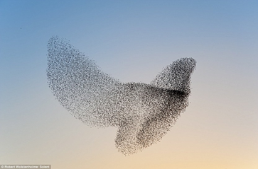
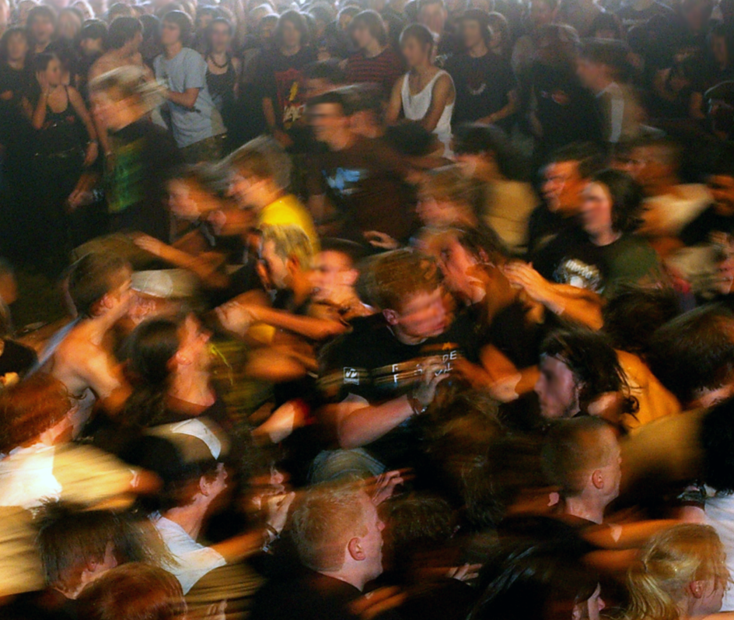

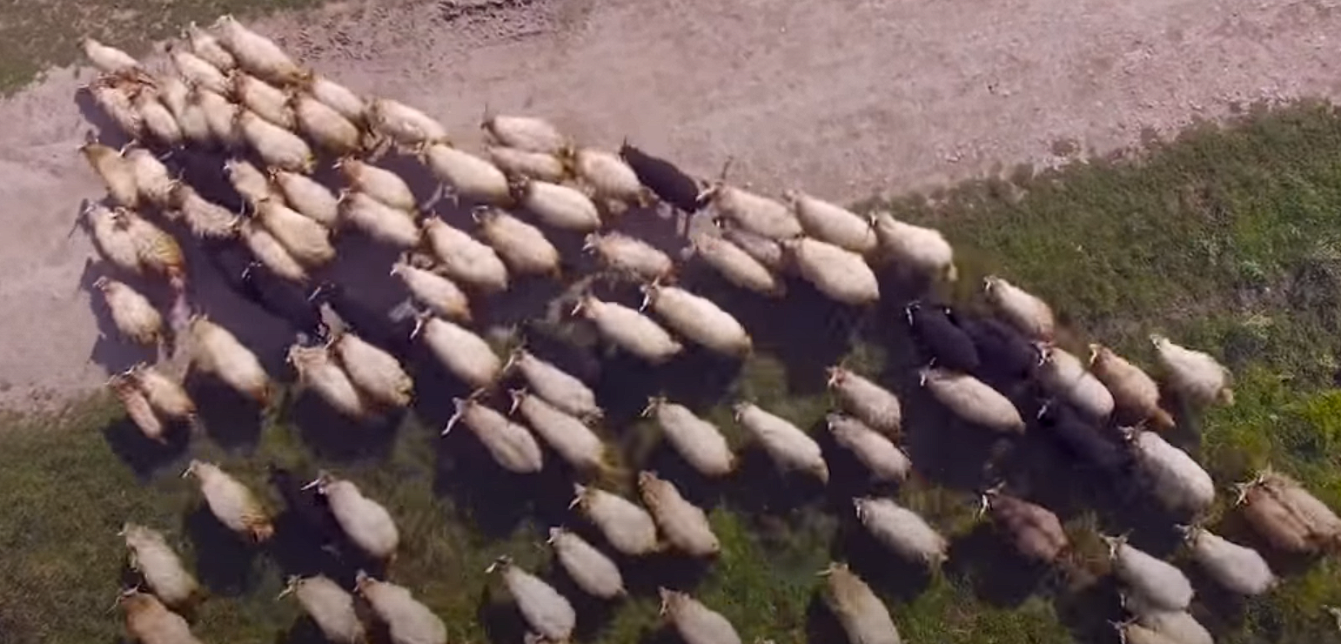
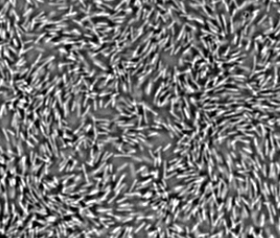
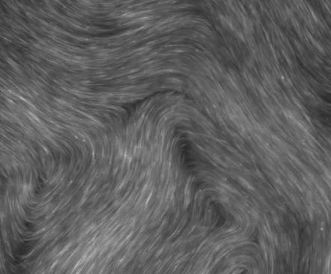
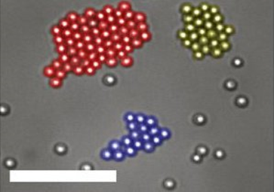
(a)
(b)
(c)
(d)
(e)
(f)
(g)
Notes:
Scalebars in (e) and (g) are 10 \textmu m. Scalebar in (f) is 200 \textmu m. Image courtesy of Robert Wolstenhome (a), Ulrike Biets \cite{Silverberg2013}(b), biographic (c, d), DeCamp \cite{DeCamp2015} (f) and Palacci \cite{Palacci2013} (g).

